Slide 1
Disclaimer
Thank you for your interest in using Google Cloud training material. We are excited about the content we are able to provide you (collectively, “Teaching Resources”) and hope you are too.
By using Teaching Resources, you agree to be bound by all of the following terms, as well as the Google terms of service and the Google privacy policy. Unless otherwise specified, terms used below will have the meanings described in the Google terms of service.
Educational Use Only. Teaching Resources is intended only for use teaching courses at regionally accredited or higher learning institutions. The content may be adapted, customize, remixed, and shared for educational use. Content may not be distributed, or otherwise exploited for any commercial purpose, commercial advantage, or private monetary compensation.
Attribution Requirements. If you distribute, publicly perform, display, transmit, publish, or otherwise make available any Teaching Resources or any derivative works thereof, you must attribute the material you use back to the Teaching Resources, but not in any way that suggests Google, any of its affiliates, or any of its third party content providers endorse you or your use of such materials. If you adapt, remix, or customize the Teaching Resources please include the following text on each edited slide: “The original content was provided by Google LLC and modified for the purpose of the course, without input or endorsement from Google LLC.”
Descriptions of Google products, services, infrastructure and processes contained in the Teaching Resources are descriptions for teaching and learning purposes only and do not constitute a guarantee, promise, or representation of accuracy by Google. Pricing, availability or features of Google Cloud products and services described in the Teaching Resources may change.
Copyright Google LLC. For educational purposes in accordance with the terms of use set forth on the program Website.

Slide 2
So, What’s the Cloud Anyway?
Copyright Google LLC. For educational purposes in accordance with the terms of use set forth on the program Website.
Notes:
Welcome to So, What’s the Cloud Anyway?, I’m ________________.

Slide 3
Course map
Module 1
Module 2
Module 3
Module 4
Module 5
So, What’s the Cloud Anyway?
Start with a Solid Platform
Use Google Cloud to Build Your Apps
Where Do I Store This Stuff?
There’s an API for That!
Module 6
Module 7
Module 8
Module 9
Module 10
You Can’t Secure the Cloud, Right?
It Helps to Network
Let Google Keep an Eye on Things
You Have the Data, but What Are You Doing with It?
Let Machines Do the Work
Google Cloud skills badges
Copyright Google LLC. For educational purposes in accordance with the terms of use set forth on the program Website.
Notes:
From this course map, you can see that you’re at the beginning of your journey through the Google Cloud Computing Foundations course. On completing the module, you’ll be able to answer the question ‘So, what’s the Cloud anyway?, and discuss why the Cloud is a technological and business game changer. Let’s look at the objectives for this module in more detail.

Slide 4

Learn how to ...
Discuss what the cloud is and why it’s a technological and business game changer
Discuss Cloud Computing
Compare and contrast physical, virtual, and cloud architectures
Define infrastructure as a service (IaaS), platform as a service (PaaS), and software as a service (SaaS)
Detail advantages to leveraging the cloud
Copyright Google LLC. For educational purposes in accordance with the terms of use set forth on the program Website.
Notes:
The objective of this module is for you to be able to discuss what the cloud is and why it’s a technological and business game changer.
The specific learning objectives to achieve this include you being able to discuss cloud computing; compare and contrast physical, virtual, and cloud architectures; define IaaS, PaaS, and SaaS infrastructures; and identify some of the advantages of leveraging the cloud.

Slide 5
Agenda
Cloud Computing
Cloud Versus Traditional Architecture
IaaS, PaaS, and SaaS
Google Cloud Architecture
Quiz
Summary
Copyright Google LLC. For educational purposes in accordance with the terms of use set forth on the program Website.
Notes:
This module starts by discussing the characteristics of cloud computing before looking at how traditional architectures compare to the cloud. We’ll then look at the key differences between Infrastructure as a Service (IaaS), Platform as a Service (PaaS), and Software as a Service (SaaS), together with the Google Cloud services that fall within these categories. The final topic will focus on Google’s specific offerings in the cloud. We’ll end the module with a short quiz and a module recap.

Slide 6
Agenda
Cloud Computing
Cloud Versus Traditional Architecture
IaaS, PaaS, and SaaS
Google Cloud Architecture
Quiz
Summary
Copyright Google LLC. For educational purposes in accordance with the terms of use set forth on the program Website.
Notes:
So let's go ahead and look at the characteristics of cloud computing.

Slide 7


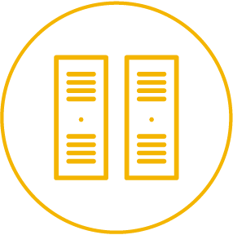


Cloud computing has five fundamental characteristics
On-demand self-service
Broad network access
Resource pooling
Rapid
elasticity
Measured service
No human intervention needed to get resources
Access from anywhere
Provider shares resources to consumers
Get more resources quickly as needed
Pay only for what you consume
Copyright Google LLC. For educational purposes in accordance with the terms of use set forth on the program Website.
Notes:
Cloud computing has five fundamental characteristics:
First, computing resources are on-demand and self-service. Cloud-computing customers use an automated interface and get the processing power, storage, and network they need, without the typical complex configurations required when building physical servers.
Second, resources are accessible over a network from any location.
Providers allocate resources to consumers from a large pool, allowing them to benefit from economies of scale. The resources exist in multiple locations all over the world, you just have to decide the available geographic location you wish to utilize.
Resources are elastic. If you need more resources you can get them rapidly. And when you need less, you can scale back.
Finally, you pay only for what you use or reserve, as you go. If you stop using resources, you simply stop paying.

Slide 8
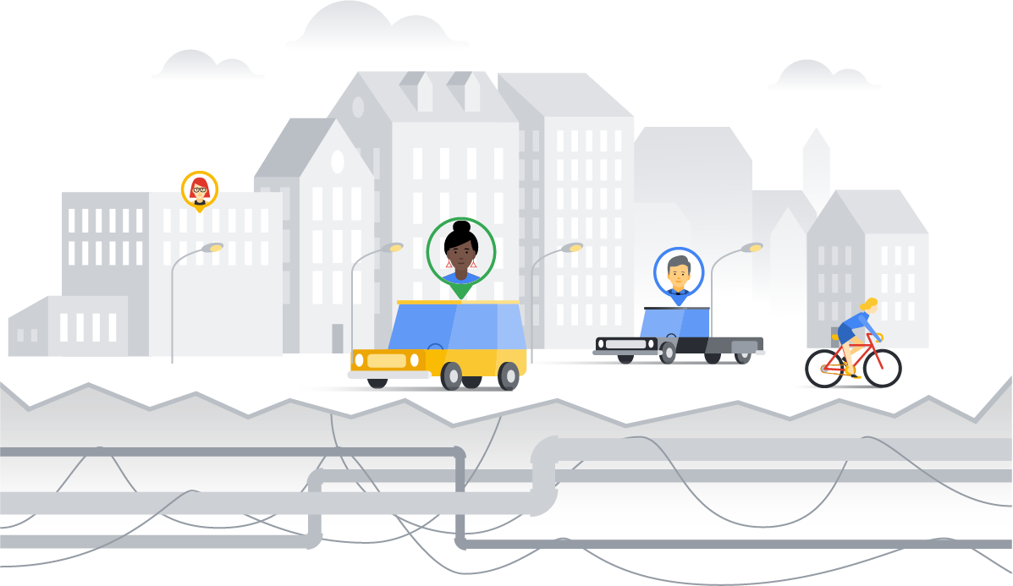
An IT infrastructure is like a "city infrastructure"
Users
Applications
Infrastructure
Copyright Google LLC. For educational purposes in accordance with the terms of use set forth on the program Website.
Notes:
Infrastructure is the basic underlying framework of facilities and systems such as transport, communications, power, water, fuel and other essential services. The people in the city are like "users," and the cars and bikes and buildings in the city are like "applications." Everything that goes into creating and supporting those applications/buildings for the users/citizens is the infrastructure.
The purpose of this course is to explore, as efficiently and clearly as possible, the infrastructure services provided by Google Cloud. You will become familiar enough with the infrastructure services to know what the services do and have a good grounding on how to use them.
By the end of this course, you will be prepared to learn anything you need to know to use Google Cloud.

Slide 9
Agenda
Cloud Computing
Cloud Versus Traditional Architecture
IaaS, PaaS, and SaaS
Google Cloud Architecture
Quiz
Summary
Copyright Google LLC. For educational purposes in accordance with the terms of use set forth on the program Website.
Notes:
So how do traditional architectures compare to the cloud? This topic aims to answer that question.

Slide 10
Cloud computing is a continuation of a long-term shift in how computing resources are managed
Third Wave
Managed service
Completely elastic storage, processing, and machine learning so that you can invest your energy in great apps. Pay for what you use.
Second Wave
Data centers (colocation)
You pay for the hardware but rent the space. Still yours to manage.
1980s
2006
2000
2009
First Wave
Server on-premises
You own everything. It’s yours to manage.
First Generation Cloud
Virtualized data centers
You rent hardware and space, but still control and configure virtual machines. Pay for what you provision.
Copyright Google LLC. For educational purposes in accordance with the terms of use set forth on the program Website.
Notes:
Cloud computing is essentially the continuation of a model where you get to rent out computing infrastructure and have it managed by dedicated professionals. Equinix and CenturyLink are two of the largest data center providers in the US. They aren’t exactly household names though. So, why are Amazon, Google, and Microsoft even in this business? In particular, why is Google doing Cloud?
The concept of cloud computing began with colocation. Instead of operating your own data center, you rented space in a colocation facility. This was the first wave of outsourcing IT. With colocation, the transfer of ownership was minimal: you still owned the machines and you maintained them. Traditionally, colocation is not thought of as cloud computing, but it did begin the process of transferring IT infrastructure out of your organization. Organizations saved money with colocation by not having to build the datacenter and the associated services. The colocation provider would simply rent all of this out to your organization.
Next, cloud computing involved virtualized data centers—virtual machines and APIs. Virtualization provides elasticity. You automate infrastructure procurement instead of purchasing hardware. With virtualization, you still maintain the infrastructure. It’s still a user-controlled/user-configured environment. This is the same as an on-premises data center, but now, the hardware is in a different location.
The next wave of cloud computing was to a fully automated, elastic cloud. This involved a move from user-maintained infrastructure to automated services. In a fully automated environment, developers don’t think about individual machines. The service automatically provisions and configures the infrastructure used to run your applications.
Google was uniquely positioned to propel organizations into this next wave of cloud computing. But what does Google have to do with Cloud?

Slide 11
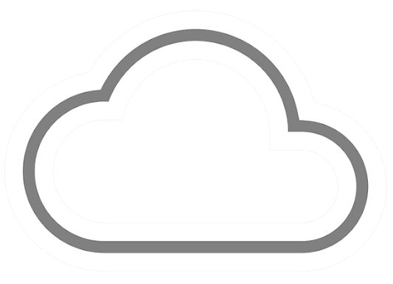
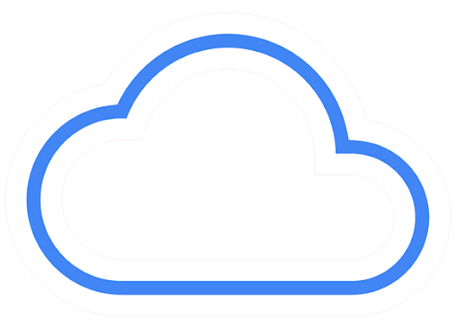

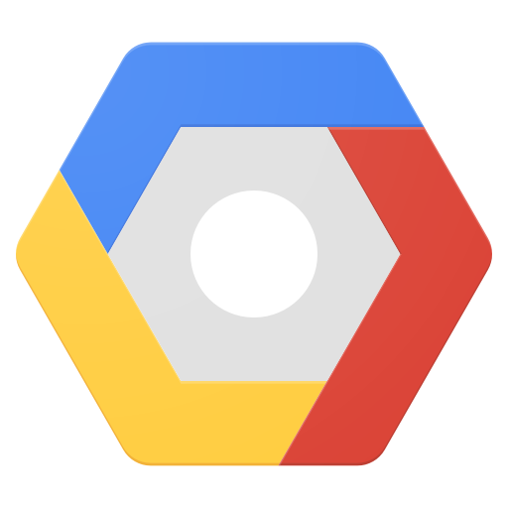




The cloud has seen a similar progression
Storage
Processing
Memory
Network
Storage
Processing
Memory
Network
Physical/Colocation
Virtualized
Serverless
User-configured, managed, and maintained
User-configured
Provider managed, and maintained
Fully automated
Copyright Google LLC. For educational purposes in accordance with the terms of use set forth on the program Website.
Notes:
As we’ve already mentioned, the first wave of the trend towards cloud computing was colocation. Colocation gave users the financial efficiency of renting physical space, instead of investing in data center real estate.
Virtualized data centers shared similarities with the private data centers and colocation facilities of decades past. The components of virtualized data centers match the physical building blocks of hosted computing—servers, CPUs, disks, load balancers, and so on—but now they’re virtual devices. Virtualization does provide several benefits: IT teams can move faster, and you can turn capital expenses into operating expenses. With virtualization you still maintain the infrastructure; it’s still a user-controlled and user-configured environment.
Around 2009, Google realized that its business couldn’t move fast enough within the confines of the virtualization model. So Google switched to a container-based architecture—a fully automated, elastic third-wave cloud that consists of a combination of automated services and scalable data. Services automatically provision and configure the infrastructure used to run applications.
Today, some services are being delivered in a fully automated, serverless way. This trend will continues as cloud services expands.

Slide 12

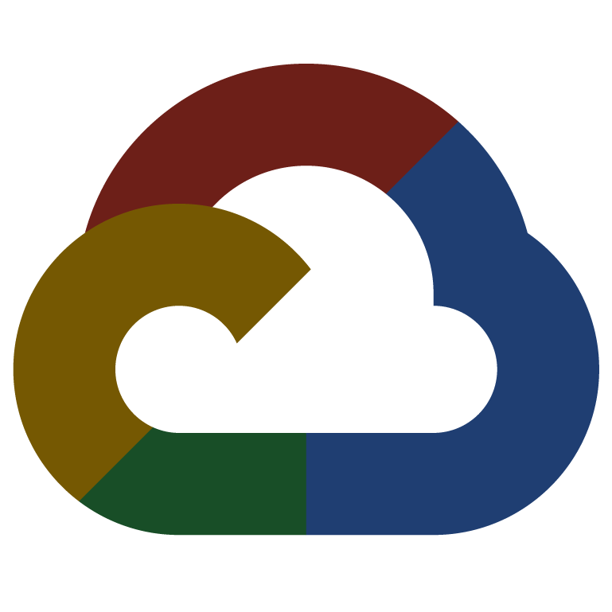
Every company is a data company
Copyright Google LLC. For educational purposes in accordance with the terms of use set forth on the program Website.
Notes:
Google believes that, in the future, every company—regardless of size or industry—will differentiate itself from its competitors through technology. Largely, that technology will be in the form of software. Great software is centered on data. Therefore, every company is, or will become, a data company.
Google Cloud provides a wide variety of services for managing and getting value from data at scale.

Slide 13
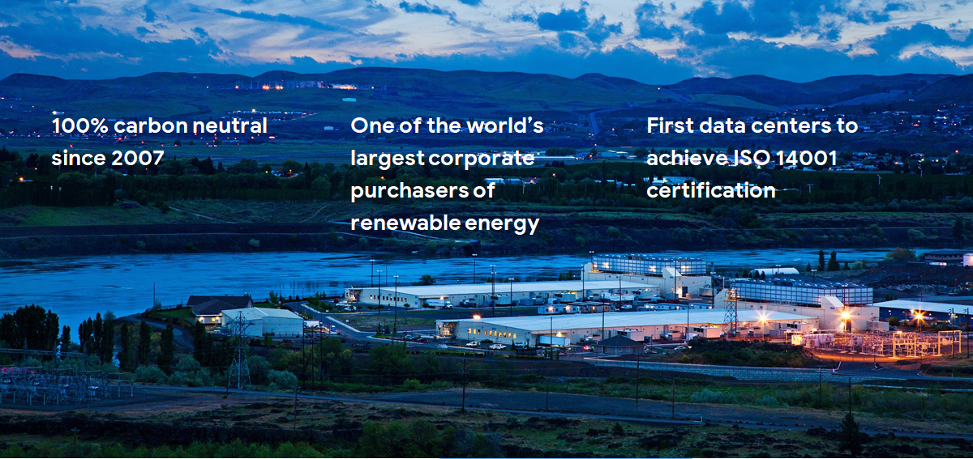
Google is committed to environmental responsibility
One of the world’s largest corporate purchasers of renewable energy
100% carbon neutral since 2007
First data centers to achieve ISO 14001 certification
Copyright Google LLC. For educational purposes in accordance with the terms of use set forth on the program Website.
Notes:
This image shows Google’s data center in Hamina, Finland. The facility is one of the most advanced and efficient data centers in the Google fleet. Its cooling system, which uses sea water from the Bay of Finland, reduces energy use and is the first of its kind anywhere in the world.
Google is one of the world’s largest corporate purchasers of wind and solar energy. It’s been 100% carbon neutral since 2007, and will shortly reach 100% renewable energy sources for its data centers.
The virtual world is built on physical infrastructure, and all those racks of humming servers use vast amounts of energy. Together, all existing data centers use roughly 2% of the world’s electricity. So Google works to make data centers run as efficiently as possible.
Google’s data centers were the first to achieve ISO 14001 certification, a standard that maps out a framework for improving resource efficiency and reducing waste.

Slide 14
Agenda
Cloud Computing
Cloud Versus Traditional Architecture
IaaS, PaaS, and SaaS
Google Cloud Architecture
Quiz
Summary
Copyright Google LLC. For educational purposes in accordance with the terms of use set forth on the program Website.
Notes:
In this next topic, we’ll discuss the key differences between infrastructure as a service (IaaS), platform as a service (PaaS), and software as a service (SaaS), together with the Google Cloud services that fall within these categories.

Slide 15
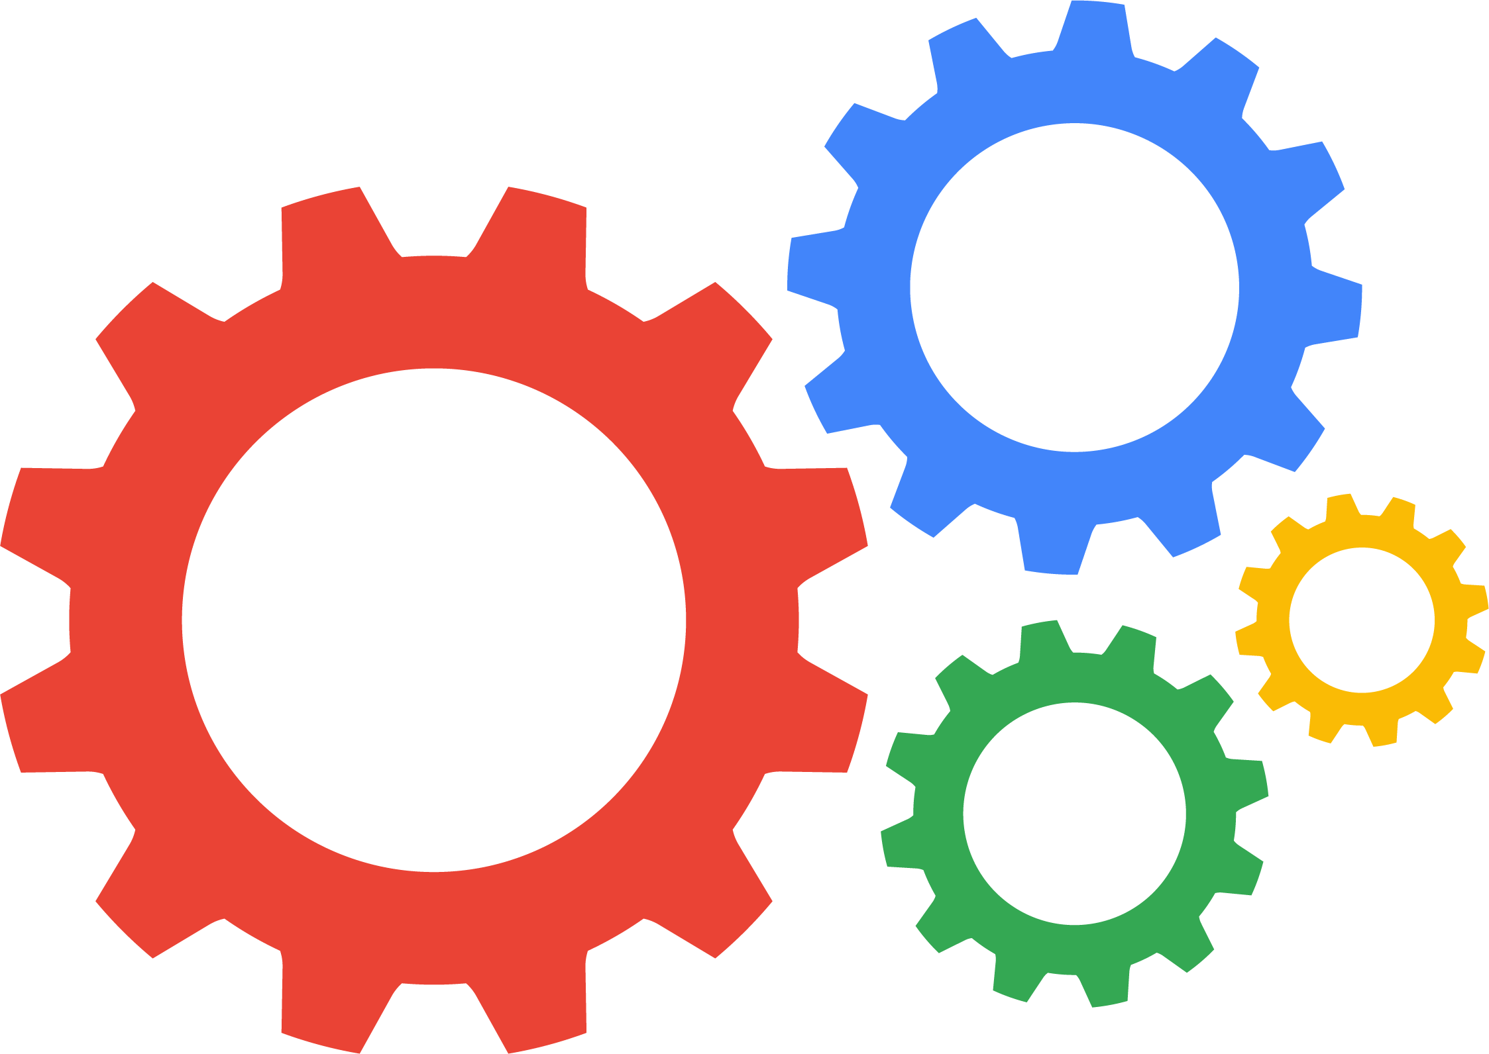


IaaS versus PaaS versus SaaS
Infrastructure as a service
(IaaS)
Platform as a service
(PaaS)
Software as a service
(SaaS)
CPU, memory, storage, and networking is provided as a service.
The user needs to manage the OS and the application.
The platform is a managed service.
All the user provides is the application.
The platform and software is provided as a service to the user.
The user supplies the data.
Copyright Google LLC. For educational purposes in accordance with the terms of use set forth on the program Website.
Notes:
With infrastructure as a service, the service provides the underlying architecture for you to run servers. The resources to run are provided, but it’s up to the user to manage the operating system and application.
Platform as a service takes it one step further. Now the entire environment will be managed for you the user, and all that is required of you is to manage your applications. The operating system layer will be managed as part of the service.
For Software as a service, the infrastructure, platform, and software is managed for you. All that’s required is that you bring your data to the system. A few commercial examples of SaaS include SAP and Salesforce.

Slide 16
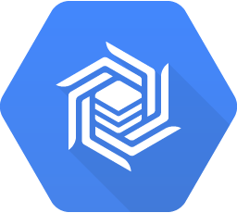
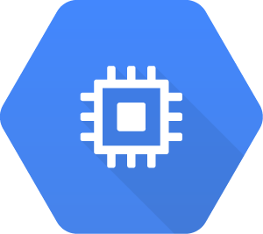
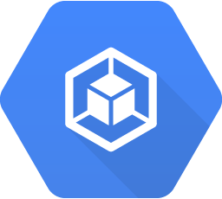
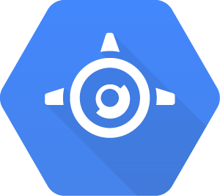
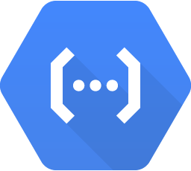
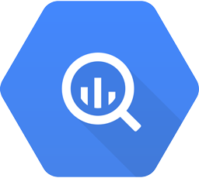

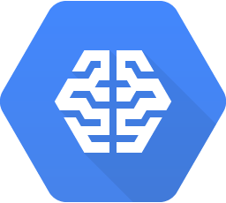
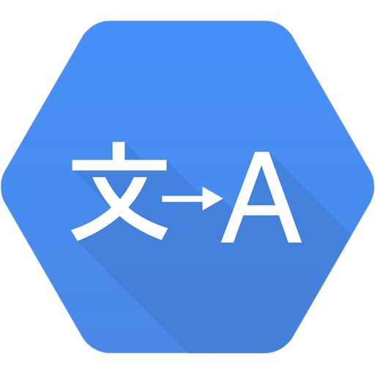
Google Cloud provides a variety of choices
Compute
Engine
App
Engine
Cloud
Functions
Managed
services
Google Kubernetes Engine
IaaS
Hybrid
PaaS
Serverless logic
Automated elastic resources
Toward managed infrastructure
Toward dynamic infrastructure
Copyright Google LLC. For educational purposes in accordance with the terms of use set forth on the program Website.
Notes:
Virtualized data centers brought you infrastructure as a service and platform as a service offerings. IaaS offerings provide you with raw compute, storage, and network, organized in ways familiar to you from physical and virtualized data centers. PaaS offerings, on the other hand, bind your code to libraries that provide access to the infrastructure your application needs, allowing you to focus on your application logic.
In the IaaS model, you pay for what you allocate. In the PaaS model, you pay for what you use.
As cloud computing has evolved, the momentum has shifted toward managed infrastructure and managed services. With managed services, rather than building complex components to work with your applications, you can leverage a service that provides high performance and high availability. For example, if your application requires a messaging service, or machine learning, or a database, rather than building these services yourself you can just use a service Google Cloud already provides. We will discuss a variety of managed services throughout this course.

Slide 17
Agenda
Cloud Computing
Cloud Versus Traditional Architecture
IaaS, PaaS, and SaaS
Google Cloud Architecture
Quiz
Summary
Copyright Google LLC. For educational purposes in accordance with the terms of use set forth on the program Website.
Notes:
Next, lets focus on Google’s specific offerings in the cloud.

Slide 18
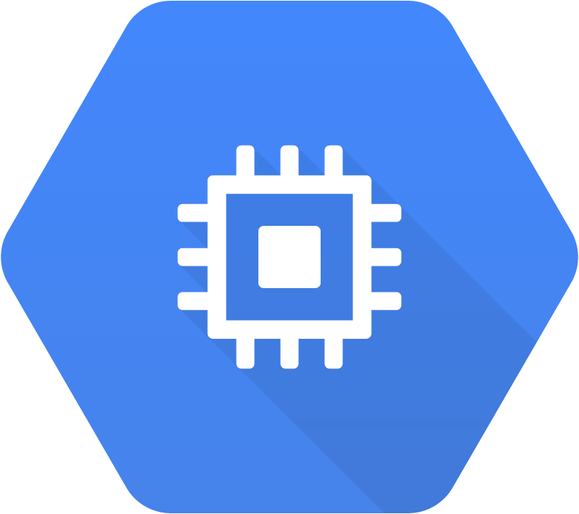
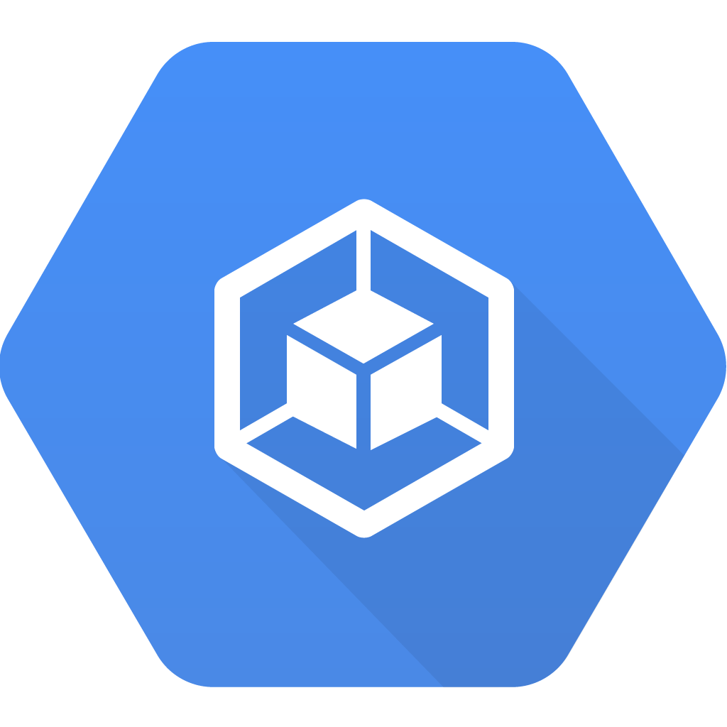
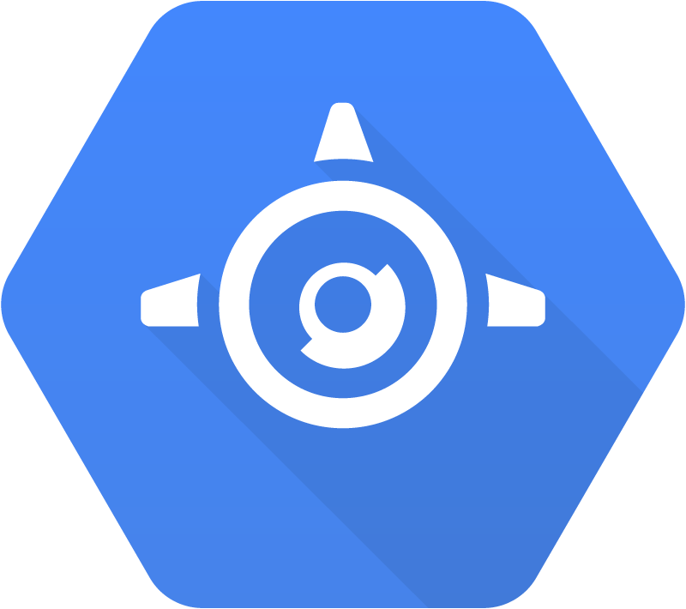
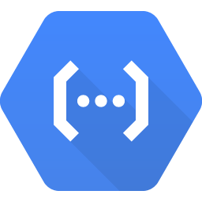
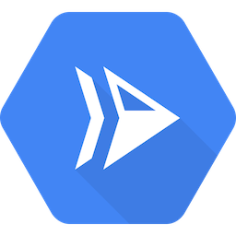
Google Cloud offers a range of compute services
Compute
Compute
Engine
Google Kubernetes Engine (GKE)
App Engine
Cloud
Functions
Cloud
Run
Copyright Google LLC. For educational purposes in accordance with the terms of use set forth on the program Website.
Notes:
Google Cloud’s products and services can be broadly categorized as Compute, Storage, Big Data, and Machine Learning. Leveraging compute can include virtual machines via Compute Engine, running Docker containers in a managed platform using Google Kubernetes Engine, deploying applications in a managed platform like App Engine, running event-based serverless code using Cloud Functions, or running stateless containers as a managed service like Cloud Run.

Slide 19
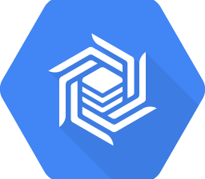
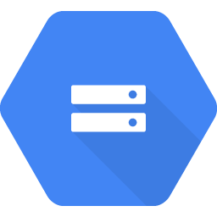
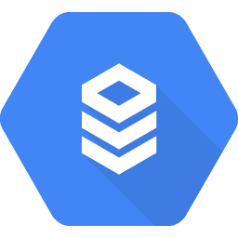
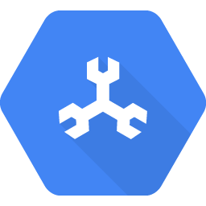
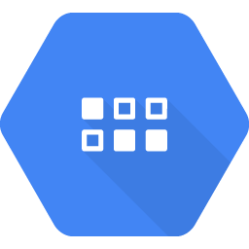
Google Cloud also offers a range of storage services
Storage
Cloud
Bigtable
Cloud
Storage
Cloud SQL
Cloud
Spanner
Datastore
Copyright Google LLC. For educational purposes in accordance with the terms of use set forth on the program Website.
Notes:
A variety of managed storage options are available as well. For unstructured storage there’s Cloud Storage, for managed relational databases there’s Cloud SQL or Cloud Spanner, and for NoSQL, there are options like Datastore or Cloud Bigtable.

Slide 20
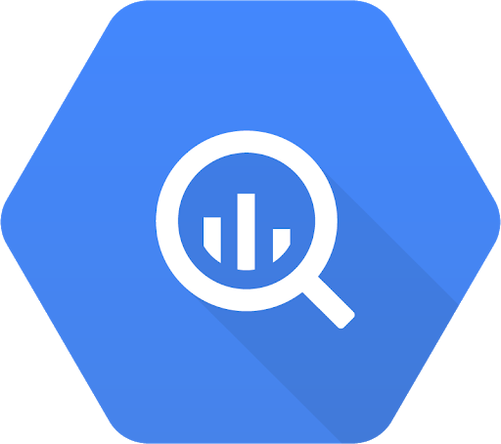
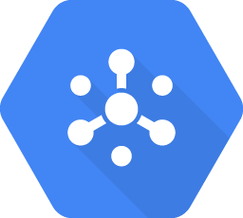
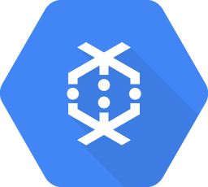
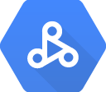
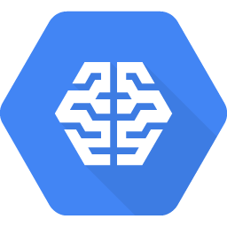
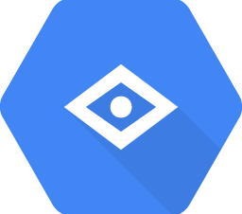
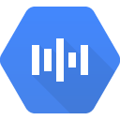
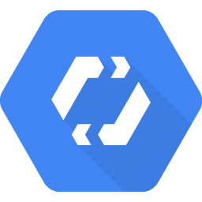
Google Cloud offers services to get value from data
Big data
BigQuery
Pub/Sub
Dataflow
Dataproc
AI Platform Notebooks
Machine learning
AI Platform
Vision API
Speech-to-Text API
Cloud Translation API
AutoML
Copyright Google LLC. For educational purposes in accordance with the terms of use set forth on the program Website.
Notes:
Managed services dealing with big data and machine learning are available as well.

Slide 21
Grace Hopper (US, UK, ES) 2022
Havfrue (US, IE, DK) 2019
Dunant (US, FR) 2020
Faster (US, JP, TW) 2016
Equiano (PT, NG, ZA) 2021
PLCN (US, TW) 2020
SJC (JP, HK, SG) 2013
Unity (US, JP) 2010
Curie (CL, US) 2019
Monet
(US, BR)
2017
Junior (Rio, Santos) 2018
JGA-S (GU, AU) 2019
Tannat (BR, UY, AR) 2018
Indigo (SG, ID, AU) 2019
Google Cloud PoPs and Network
Edge point of presence
Network
Copyright Google LLC. For educational purposes in accordance with the terms of use set forth on the program Website.
Notes:
Google’s data centers around the world are interconnected by the Google network, which, by some publicly available estimates, carries as much as 40% of the world’s internet traffic every day. This is the largest network of its kind on Earth, and it continues to grow.
It’s designed to provide the highest possible throughput and the lowest possible latencies for applications.
The network interconnects with the public internet at more than 90 internet exchanges and more than 110 points of presence worldwide. When an internet user sends traffic to a Google resource, Google responds to the user's request from an Edge Network location that will provide the lowest delay or latency. Google’s edge caching network places content close to end users to minimize latency. Applications in Google Cloud can take advantage of this edge network too.

Slide 22

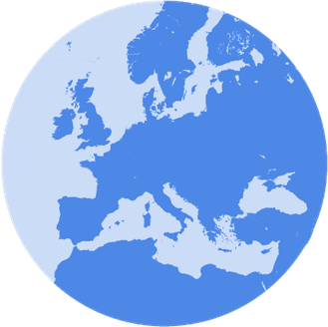

Google Cloud provides resources in multi-regions, regions, and zones
Multi-Region
Region
Zone
europe-west2-a
europe-west2-b
europe-west2-c
US
Europe
europe-west2
Copyright Google LLC. For educational purposes in accordance with the terms of use set forth on the program Website.
Notes:
Google Cloud divides the world into three multi-regional areas: the Americas, Europe, and Asia Pacific.
Next, the three multi-regional areas are divided into regions, which are independent geographic areas on the same continent. Within a region, there’s fast network connectivity: generally round-trip network latencies of under 1 millisecond (that is, at the 95th percentile).
Finally, regions are divided into zones, which are deployment areas for Google Cloud resources within a focused geographic area. You can think of a zone as a data center within a region, although strictly speaking a zone isn’t necessarily a single data center.
Compute Engine virtual-machine instances reside within a specific zone. If that zone became unavailable, so would your virtual machine and the workload running on it.
Deploying applications across multiple zones enables fault tolerance and high availability.

Slide 23
Finland
Netherlands
London
Warsaw
Montréal
Belgium
Frankfurt
Toronto
Paris
Oregon
Iowa*
Zurich
Milan
Salt Lake City
N. Virginia
Madrid
Las Vegas
Seoul
Tokyo
Los Angeles
S. Carolina
Osaka
Doha
Delhi
Taiwan
Mumbai
Hong Kong
Singapore
Jakarta
São Paulo
Santiago
Sydney
Melbourne
Current region with 3 zones
Future region with 3 zones
Google Cloud Regions and Zones
* Exception: region has 4 zones.
Copyright Google LLC. For educational purposes in accordance with the terms of use set forth on the program Website.
Notes:
Behind the services provided by Google Cloud lie a huge range of Google Cloud resources: physical assets, such as physical servers and hard disk drives; and virtual resources, such as virtual machines and containers. These resources are managed by Google within its global data centers. As of mid-2019, Google Cloud has expanded across 20 regions, 61 zones, and more than 200 countries and territories. This expansion will continue.

Slide 24
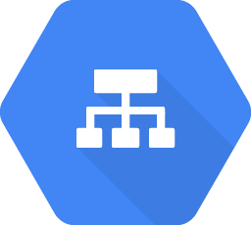
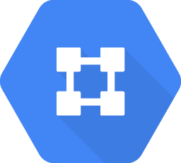
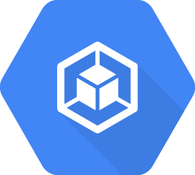
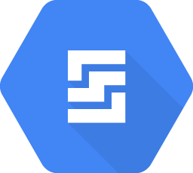
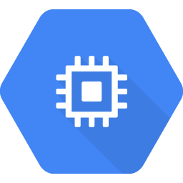
Resources are organized both physically and logically
Global
HTTP(S) load balancer
Virtual Private Cloud
Regional
Regional
Regional GKE cluster
Datastore
Zonal
Zonal
Persistent Disk
GKE
node
Compute Engine instance
Persistent
Disk
Physical organization
Copyright Google LLC. For educational purposes in accordance with the terms of use set forth on the program Website.
Notes:
When you take advantage of Google Cloud services and resources, you get to specify those resources’ geographical locations. In many cases you can also specify whether you’re doing so on a zonal level, a regional level, or a multi-regional level.
Zonal resources operate within a single zone, which means that if a zone becomes unavailable, the resources won’t be available either. A simple example would be a Compute Engine virtual machine instance and its persistent disks. GKE has a component called a “node,” and these are zonal too.
Regional resources operate across multiple zones, but within one region. An application using these resources can be redundantly deployed to improve its availability.
Finally, global resources can be managed across multiple regions. These resources can further improve the availability of an application. Some examples of such resources include HTTPS load balancers and Virtual Private Cloud networks.

Slide 25
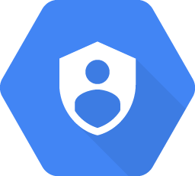
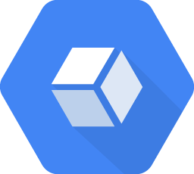
Resources are organized both physically and logically
Global
Project-1
HTTP(S) load balancer
Virtual Private Cloud
Regional
Regional
Regional GKE cluster
Datastore
Zonal
Zonal
Persistent Disk
GKE
node
Compute Engine instance
Persistent
Disk
Physical organization
Logical organization
Copyright Google LLC. For educational purposes in accordance with the terms of use set forth on the program Website.
Notes:
The Google Cloud resources you use, no matter where they reside, must belong to a project. So what is a project?
A project is the base-level organizing entity for creating and using resources and services and managing billing, APIs, and permissions. Zones and regions physically organize the Google Cloud resources you use, and projects logically organize them. Projects can be easily created, managed, deleted, or even recovered from accidental deletions.

Slide 26
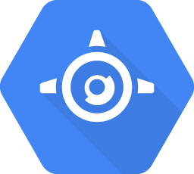
Resources have hierarchy
Organization
Organization
Folders
Team A
Team B
Product 1
Product 2
Projects
Store front
Test project
Production
Resources
GKE
Cloud Storage bucket
Compute Engine instance
App Engine service
Copyright Google LLC. For educational purposes in accordance with the terms of use set forth on the program Website.
Notes:
Each project is identified by a unique project ID and project number. You can name your project and apply labels for filtering. These labels are changeable, but the project ID and project number remain fixed.
Projects can belong to a “folder” which is another grouping mechanism.
You should use folders to reflect the hierarchy of your enterprise and apply policies at the right levels in your enterprise. You can nest folders inside folders. For example, you can have a folder for each department, and within each department’s folder, you can have subfolders for each of the teams that make it up. Each team’s projects belong to its folder.
A single organization owns the folders beneath it. An organization is the root node of a Google Cloud resource hierarchy. Although you are not required to have an organization to use Google Cloud, organizations are very useful. Organizations let you set policies that apply throughout your enterprise. Also, having an organization is required to use folders.
The Google Cloud resource hierarchy helps you manage resources across multiple departments and multiple teams within an organization.
You can define a hierarchy that creates trust boundaries and resource isolation. For example, should members of your Human Resources team be able to delete running database servers? And should your engineers be able to delete the database containing employees’ salaries? Probably not, in either case!
Cloud Identity and Access Management, also called Cloud IAM ***I-A-M*** , lets you fine-tune access control to all the Google Cloud resources you use. You define IAM policies that control user access to resources.

Slide 27
Agenda
Cloud Computing
Cloud Versus Traditional Architecture
IaaS, PaaS, and SaaS
Google Cloud Architecture
Quiz
Summary
Copyright Google LLC. For educational purposes in accordance with the terms of use set forth on the program Website.
Notes:
So let's test what we have learned with a quiz.

Slide 28
Scenario #1
Question
Which of the following is not a fundamental attribute of the cloud?
On-demand self-service
Resource pooling
Security as a service
Rapid elasticity
Copyright Google LLC. For educational purposes in accordance with the terms of use set forth on the program Website.
Notes:
Which of the following is not a fundamental attribute of the cloud?

Slide 29
Scenario #1
Answer
Which of the following is not a fundamental attribute of the cloud?
On-demand self-service
Resource pooling
Security as a service
Rapid elasticity
Copyright Google LLC. For educational purposes in accordance with the terms of use set forth on the program Website.
Notes:
The answer is C, Security as a Service, which does not exist.

Slide 30
Scenario #2
Question
Select the PaaS resource from the available options.
App Engine
Compute Engine
Cloud Functions
Google Kubernetes Engine
Copyright Google LLC. For educational purposes in accordance with the terms of use set forth on the program Website.
Notes:
Select the PaaS resource from the available options.

Slide 31
Scenario #2
Answer
Select the PaaS resource from the available options.
App Engine
Compute Engine
Cloud Functions
Google Kubernetes Engine
Copyright Google LLC. For educational purposes in accordance with the terms of use set forth on the program Website.
Notes:
App Engine is Google’s platform as a service.

Slide 32
Scenario #3
Question
Which of the following is an example of a zonal resource?
Datastore
Compute Engine
HTTP(S) Load Balancer
Virtual Private Cloud
Copyright Google LLC. For educational purposes in accordance with the terms of use set forth on the program Website.
Notes:
Which of the following is an example of a zonal resource?

Slide 33
Scenario #3
Answer
Which of the following is an example of a zonal resource?
Datastore
Compute Engine
HTTP(S) Load Balancer
Virtual Private Cloud
Copyright Google LLC. For educational purposes in accordance with the terms of use set forth on the program Website.
Notes:
Compute Engine is an example of a zonal resource.

Slide 34
Agenda
Cloud Computing
Cloud Versus Traditional Architecture
IaaS, PaaS, and SaaS
Google Cloud Architecture
Quiz
Summary
Copyright Google LLC. For educational purposes in accordance with the terms of use set forth on the program Website.
Notes:
That concludes the ‘So, what's the cloud anyway?’ module. The simple answer to this question is that the cloud, or cloud computing, refers to software and services that run on the internet instead of locally on a computer. The advantage of the cloud is that you can access your information on any device with an internet connection. Another benefit of the cloud is that, because the remote servers handle much of the computing and storage, you don’t necessarily need an expensive, high-end machine to get your work done. Let’s look at some of the key learning points from this module.

Slide 35
Summary (1/2)
Cloud computing has five fundamental characteristics.
An IT infrastructure can be compared to a “city infrastructure.”
Cloud computing is a continuation of a long-term shift in how computing resources are managed.
IaaS, PaaS, and SaaS provides users with increasing levels and choices of managed services.
Copyright Google LLC. For educational purposes in accordance with the terms of use set forth on the program Website.
Notes:
At the start of this module, we learned that cloud computing has five fundamental characteristics: on-demand self-service; broad network access, resource pooling, rapid elasticity, and measured service.
We also drew comparisons between a typical city infrastructure and an IT infrastructure.
We then discussed how cloud computing is a continuation of a long-term shift in how computing resources are managed, looking back to how things were in the 1980s, how things changed through to today, where we’re heading next, and Google’s unique positioning to propel organizations into the next wave of cloud computing.
We discussed the key differences between infrastructure as a service, which provides the underlying architecture to run servers, platform as a service, which manages the environment for the user, leaving them to manage their applications, and software as a service, which manages the infrastructure, platform, and software, requiring users to only bring their data to the system.

Slide 36
Summary (2/2)
Google Cloud offers a wide range of services.
Google Cloud divides the world into regions and zones.
The Google Cloud resources you use, no matter where they reside, must belong to a project.
Copyright Google LLC. For educational purposes in accordance with the terms of use set forth on the program Website.
Notes:
In the final topic, you were introduced to a wide range of services that Google Cloud offers in the areas of compute, storage, networking, big data, and machine learning.
You were also introduced to the scope of the Google network, as well as the concepts of regions and zones.
Lastly, we discussed the relationship between Google Cloud resources and projects.

